Slide 1
Sets

Slide 2
Set Semantics
A set is, perhaps the simplest possible container, since it contains objects in no particular order with no particular identification.
Since each object stands for itself; elements of a set cannot be duplicated.
>>>set(("hello", "world", "of", "words", "of", "world") )
set(['world', 'hello', 'words', 'of'])

Slide 3
Set Semantics
A set has large number of operations for unions, intersections, and differences.
A common need is to examine a set to see if a particular object is a member of that set, or if one set is contained within another set.

Slide 4
Set Semantics
A set is mutable, which means that it cannot be used as a key for a dict.
In order to use a set as a dict key, we can create a frozenset, which is an immutable copy of a set. This allows us to accumulate a set of values to create a dict key.

Slide 5
Set Literal Values
set(iterable) → set
Transforms the given iterable into a set.
set(iterable) → frozenset
Transforms the given iterable into an immutable frozenset.

Slide 6
Creating sets
>>> x = set("A Python Tutorial")
>>> x
set(['A', ' ', 'i', 'h', 'l', 'o', 'n', 'P', 'r', 'u', 't', 'a', 'y', 'T'])
>>> type(x)
<type 'set'>

Slide 7
Creating sets
>>> x = set(["Perl", "Python", "Java"])
>>> x
set(['Python', 'Java', 'Perl'])

Slide 8
Creating sets
>>> cities = set(("Paris", "Lyon", "London","Berlin","Paris","Birmingham"))
>>> cities
set(['Paris', 'Birmingham', 'Lyon', 'London', 'Berlin'])

Slide 9
Immutable Sets
Sets are implemented in a way, which doesn't allow mutable objects.
cities = set((("Python","Perl"), ("Paris", "Berlin", "London")))
cities = set((["Python","Perl"], ["Paris", "Berlin", "London"]))
TypeError: unhashable type: 'list'

Slide 10
Frozenset - Example
The frozenset type is immutable and hashable - its contents cannot be altered after it is created; it can therefore be used as a dictionary key or as an element of another set.
>>>a = frozenset([1,1,1,1,2,3])
>>> b = frozenset([3,3,3,3,2,1])
>>> {a:1, b:2}
{frozenset([1, 2, 3]): 2}

Slide 11
Frozenset – Example
frozenset([1,2,2,3,3]) == frozenset([3,2,1,1,1]) True
>>>d = {}
>>> d[frozenset([1,1,2,3])] = 'hello'
>>> d[frozenset([1,2,3,3])]
'hello'
>>> d[frozenset([3,3,3,2,1,1,1])]
'hello'
>>> d[frozenset([2,1,3])]
'hello'

Slide 12
Compare frozenset and set
frozenset() objects can be used as dictionary keys and as values inside of set() and frozenset() objects, where set objects cannot.
set() values are mutable and not hashable, frozenset() values are immutable and are hashable.

Slide 13
Compare frozenset and set
Though sets can't contain mutable objects, sets are mutable
>>> cities = set(["Frankfurt", "Basel","Freiburg"])
>>> cities.add("Strasbourg")
>>> cities
set(['Freiburg', 'Basel', 'Frankfurt', 'Strasbourg'])

Slide 14
Compare frozenset and set
Frozensets are like sets except that they cannot be changed, i.e. they are immutable
>>> cities = frozenset(["Frankfurt", "Basel","Freiburg"])
>>> cities.add("Strasbourg")
AttributeError: 'frozenset' object has no attribute 'add'

Slide 15
Hashable
Hashable objects which compare equal must have the same hash value.
All of Python's immutable built-in objects are hashable; mutable containers (such as lists or dictionaries) are not.

Slide 16
hash() function
print('Hash for 181 is:', hash(181))
print('Hash for 181.23 is:',hash(181.23))
print('Hash for Python is:', hash('Python'))
Hash for 181 is: 181
Hash for 181.23 is: 530343892119126197
Hash for Python is: 2230730083538390373

Slide 17
hash() function
print('Hash for 181 is:', hash(181))
print('Hash for 181.23 is:',hash(181.23))
print('Hash for Python is:', hash('Python'))
Hash for 181 is: 181
Hash for 181.23 is: 530343892119126197
Hash for Python is: 2230730083538390373

Slide 18
What is a hash
A hash is a fixed size integer which identifies a particular value.
Same data will have same hash value.
Even a slight change in original data can result in a completely different hash value.
A hash is obtained from a hash function, whose responsibility is to convert the given information to encoded hash.
Clearly, the number of objects can be much more than the number of hash values and so, two objects may hash to the same hash value. This is called Hash collision. This means that if two objects have the same hash code, they do not necessarily have the same value.

Slide 19
Example - hashing
name = "Shubham"
hash1 = hash(name)
hash2 = hash(name)
print("Hash 1: %s" % hash1)
print("Hash 2: %s" % hash2)
Hash1: -6198559587767564025
Hash2: -6198559587767564025

Slide 20
Example - hashing
name1 = "Shubham"
name2 = "Shubham!"
hash1 = hash(name1)
hash2 = hash(name2)
print("Hash 1: %s" % hash1)
print("Hash 2: %s" % hash2)
Hash1: -4341208365040654583
Hash2: 1405247277152075764

Slide 21
Python hashing
In Python, we have two objects that uses hash tables, dictionaries and sets.
A dictionary is a hash table and is called an associative array. In a dictionary, only keys are hashed and not the values. This is why a dictionary key should be an immutable object as well while values can be anything, even a list which is mutable.
A set contains unique objects which are hashable. If we have non-hashable items, we cannot use set and must instead use list.

Slide 22
Why mutable objects cannot be Hashed?
As we already know, only immutable objects can be hashed.
This restriction of not allowing a mutable object to be hashed simplify the hash table a lot.
If a mutable object is allowed to be hashed, we need to update the hash table every time the value of the objects updates.
This means that we will have to move the object to a completely different bucket.
This is a very costly operation to be performed.

Slide 23
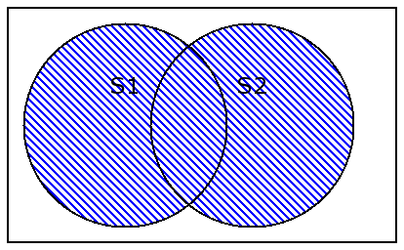
Set Operations - Union
>>> fib=set( (1,1,2,3,5,8,13) )
>>> prime=set( (2,3,5,7,11,13) )
>>>fib | prime
set([1, 2, 3, 5, 7, 8, 11, 13])

Slide 24
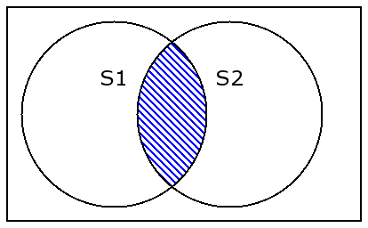
Set Operations - Intersection
>>> fib=set( (1,1,2,3,5,8,13) )
>>> prime=set( (2,3,5,7,11,13) )
>>>fib & prime
set([2, 3, 5, 13])

Slide 25
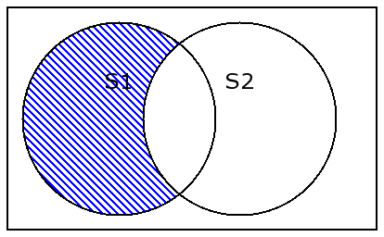
Set Operations - Difference
>>> fib=set( (1,1,2,3,5,8,13) )
>>> prime=set( (2,3,5,7,11,13) )
>>>fib - prime
set([1, 8])
>>>prime – fib
set([11,7])

Slide 26
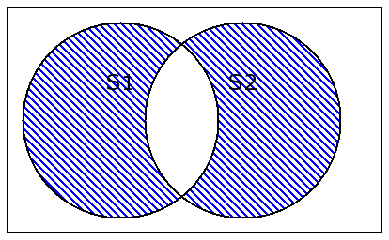
Set Operations – Symmetric difference
>>> fib=set( (1,1,2,3,5,8,13) )
>>> prime=set( (2,3,5,7,11,13) )
>>>fib ^ prime
set([1, 7, 8, 11])

Slide 27
Set Comparison
<, <=, >, >=, ==, !=, in, not in
>>> craps= set( [ (1,1), (2,1), (1,2), (6,6) ] )
>>> three = set( [ (1,2), (2,1) ] )
>>> three < craps
True
>>> three <= craps
True

Slide 28
Set Comparison
>>> craps= set( [ (1,1), (2,1), (1,2), (6,6) ] )
>>> (1,2) in craps
True
>>> (3,4) in craps
False

Slide 29
Set Statements
>>> even= set( range(2,38,2) )
>>> odd= set( range(1,37,2) )
>>> zero= set( (0,'00') )
>>> for n in even|odd|zero:
print n

Slide 30
Set Built-in Functions
Functions which apply to sets, but are defined elsewhere.
>>> len( set( [1,1,2,3] ) )
3
>>> len( set() )
0
>>> max( set( [1,1,2,3,5,8] ) )
8
(Similarly for min)

Slide 31
Set Built-in Functions
>>> sum( set( [1,1,2,3,5,8] ) )
19
any() - For sets, Return True if there exists any item which is True.
>>> set( [0, None, False] )
set([0, None])
>>> any( _ ) False
>>> any( set( [0,None,False,42] ) )
True

Slide 32
Set Built-in Functions
all() - For sets, Return True if all items are True.
>>> all( set( [0,None,False,42] ) )
False
>>> all( set( [1,True] ) )
True
>>> sorted( set( [1,1,2,3,5,8] ) )
[1, 2, 3, 5, 8]

Slide 33
Set Built-in Functions
enumerate(). Iterate through the set returning 2-tuples of ( index, item ).
Since sets have no explicit ordering to their items, this enumeration is in an arbitrary order.

Slide 34
Set Methods
set.clear()
Remove all items from the set.
set.pop() → object
Remove an arbitrary object from the set, returning the object. If the set was already empty, this will raise a KeyError exception.

Slide 35
…. A lot more methods

